Slide 1
IBlogger
A directory of wonderful things…

Slide 2

SHRI SHAMBHUBHAI V. PATEL COLLEGE OF
COMPUTER SCIENCE & BUSINESS MANAGEMENT
Affiliated To
VEER NARMAD SOUTH GUJARAT UNIVERSITY, SURAT
A PROJECT REPORT ON
BLOG MANAGEMNET SYSTEM
AS A PARTIAL REQUIREMENT FOR THE DEGREE OF
BACHELOR OF COMPUTER APPLICATION [ BCA ]
_____________________________________________ _____________________________________________
SUBMITTED BY: GUIDED BY:
Chodvadiya Neel S. [039] Prof. Riddhi Joshi
Balar Axit M. [011] Date :-
Dhanani Rohan J. [057] 23/04/2022

Slide 3
ACKNOWLEDGEMENT
Our self Chodvadiya Neel, Balar Axit and Dhanani Rohan. Have opportunity to express our knowledge. we would like to express our gratitude to all those who gave us the possibility to complete our project.
Success is such a comprehensive project can not achieve single-handed. It is team effort that sails the ship to the coast. so we would like to express our sincere thanks to all the dignitaries who were involve in making this project the great joy and turning it our into successful piece of work.
Prof. Riddhi Joshi – our professor and project co-ordinates has been very prudent to us threw out the collage studies. They are the person who has giving this direction to our work and the shape to our imagination. we express our regard to them from the core of our heart.
From,
Chodvadiya Neel S.
Balar Axit M.
Dhanani Rohan J.

Slide 4
Project Profile
Field | Details
Project Name: | IBlogger
Technology: | Node.js, React.js, Express.js, MongoDB, Html, Css, Bootstrap, Javascript.
Front End: | React.js
Back End: | Node.js / Express.js
Browser: | All browsers are supported.
Internal Guide: | Prof. Riddhi Joshi
Platform: | Node.js -16.14.0, React.js -17.0.2
Tool Used For:- | Visual Studio Code, MongoDB Compass, Postman.
Submitted To: | Shree Shambhubhai V Patel College Of Computer Science & Business Management
Developed By: | Chodvadiya Neel S. Balar Axit M. Dhanani Rohan J.

Slide 5
Project Description
A blog is a frequently updated online personal journal or diary. It is a place to express yourself to the world. A place to share your thoughts and your passions. Really, it’s anything you want it to be.
For our purposes we’ll say that a blog is your own website that you are going to update on an ongoing basis.
Blog is a short form for the word we blog and the two words are used interchangeably.
Features :-
Online Blogging System is a perfect platform for students, teachers, institutional , administrative purposes.
Before take any type of service, User have to register first.
Home page display all categories of Blog and The Online Blogging System will allow the users to publish the writings, images if he/she should have credentials to login.
After the user insert the blog, the blog goes to the admin and the admin check and verify the blog and then the blog is displayed to the rest of the users.

Slide 6
Hardware and software requirement
Client Side :
Internet enabled device with web-browser.
Server side :
Node.js - 14.16.1
MongoDB Database
Development Side
Processor : Intel core i5 11th generation
O.S : Windows 10
Memory : 8.00 GB
Hard disk : 1TB
Web Browser : Google Chrome (Recommended)

Slide 7


Technology used
Overview of React.js :-
React is a JavaScript library for building user interfaces.
React is a library for building compassable user interfaces. It encourages the creation of reusable UI components, which present data that change over time.
Overview of Node.js :-
Node.js is a server-side platform built on Google Chrome's JavaScript Engine (V8 Engine).
Node.js is an open source, cross-platform runtime environment for developing server-side and networking applications.

Slide 8




Existing system and its drawbacks
Our aim is to reach people through the latest news and students also have a way of learning new languages by instant blog.
Existing System
Blogger.com
Medium.com
Wordpress.org
Dev.to

Slide 9
Existing system and its drawbacks
Drawbacks:
Blogger.com is Free and easy to use, hosting and maintenance is taken care of. Its main drawbacks is that it is Limited to basic blogging tools and lack of design options and you can not provide category search.
Blogger displays advertisements on your blog
Limited to basic blogging tools and there is no way to add additional features
In medium All blogs on Medium look the same, there are hardly any customization options. No way to transfer your audience from Medium to any other platform. Monetization options are absent. And you can not search any blog on their category.

Slide 10
Project scope
The Online Blogging System will allow the users to publish the writings, blogs, images or if he/she should have credentials to login. The main users of this project are users and administrators.
The Online Blogging System project consists of following functional elements :-
Blog: Here we can see all the published contents by clicking on “All Blogs” option and we can also publish new content by “Create Blog” option.
Media: We can see the uploaded media items ( images ) by clicking on “Add Image” option and we can also add new media item from local system with the help of “Add Image” button.
Comments: In this section, we can check that who, when and what has been commented.
Profile: In this section, we can personalize our profile, Password Change, Profile Picture Change, Display Name, Nickname etc.
Feedbacks: User can give feedbacks about our website and blog.
Blog Category : User can view blogs categories wise.

Slide 11
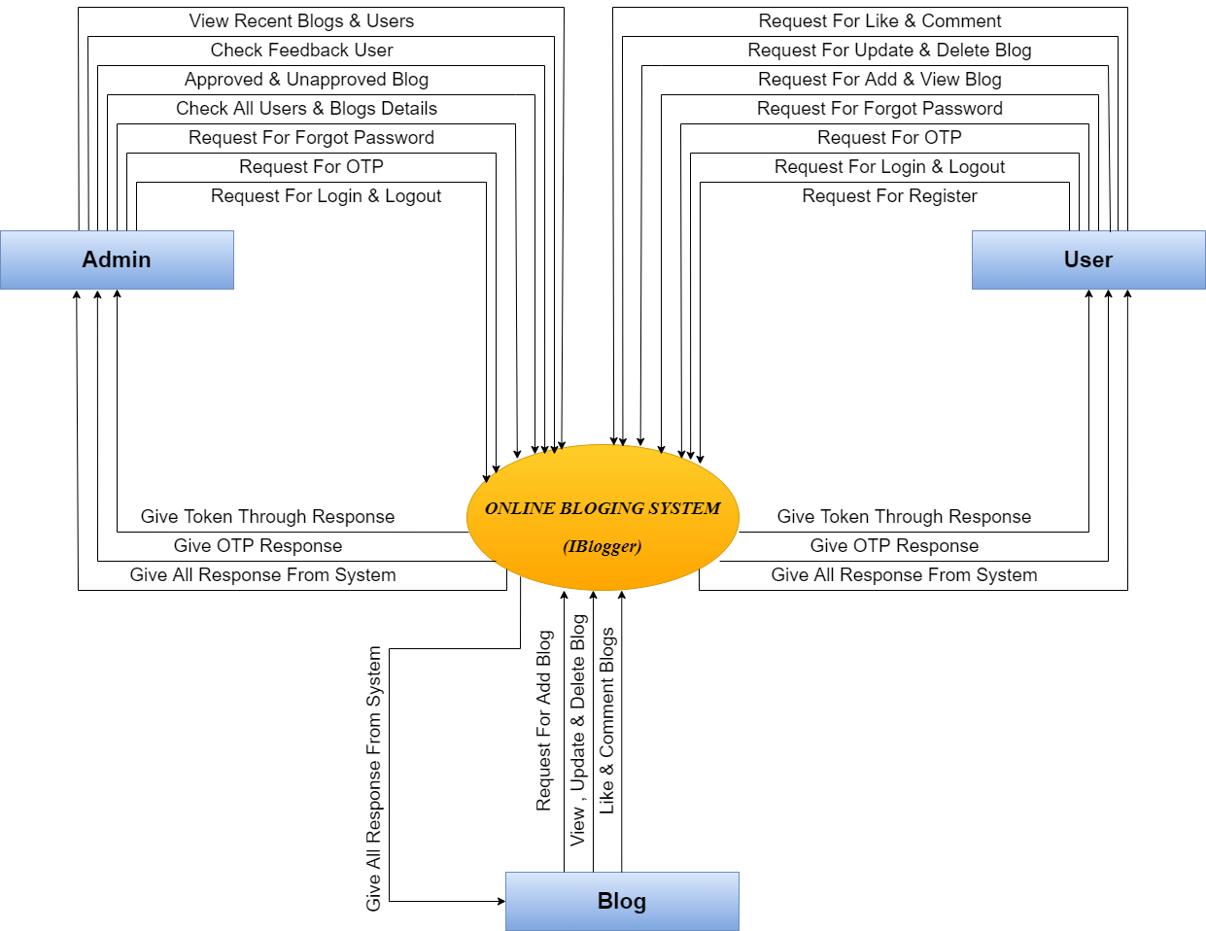
Data flow diagram

Slide 12
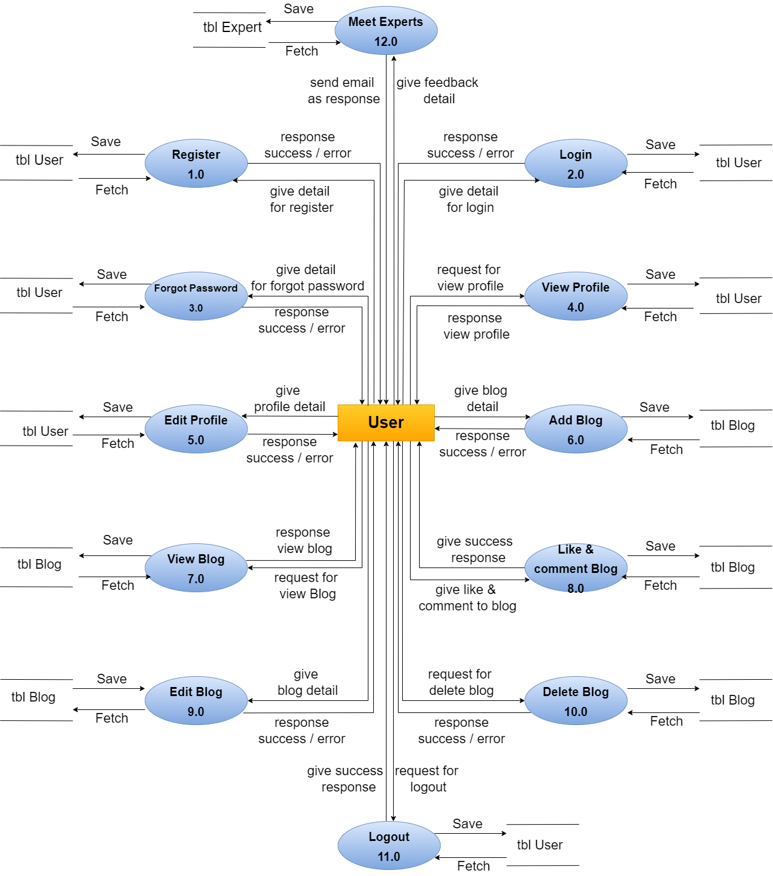

Slide 13
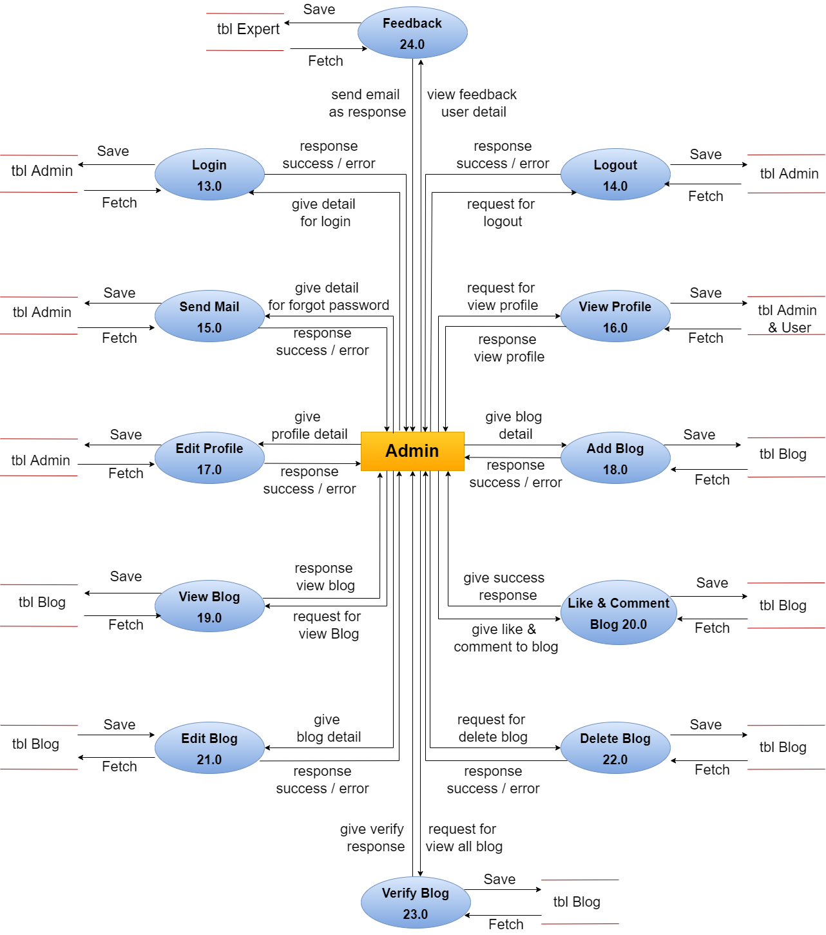

Slide 14
Data dictionary ( user table )
Field | Type | Null | Key | Description
User_id | Autogenerate | Null | Primary | User_id is unique id of user data.
Name | String | Not Null |  | It displays user’s name.
Email | Email form | Not Null |  | It displays user’s email.
Gender | String | Not Null |  | It displays user’s gender.
Phone | Number | Not Null |  | It displays user’s phone number.
Username | String | Not Null |  | It displays user’s username.
Password | Password (encrypted) | Not Null |  | It displays user’s password.
Images | Files | Not Null |  | It displays user’s profile image.
Image path | String | Null |  | It displays user’s image path.
Token | String (Autogenerate) | Null |  | It displays user’s login token.
Date & Time | String (Autogenerate) | Null |  | It displays user’s register date and time.

Slide 15
Data dictionary ( admin table )
Field | Type | Null | Key | Description
Admin_id | Autogenerate | Null | Primary | Admin_id is unique id of admin data.
Name | String | Not Null |  | It displays admin’s name.
Email | Email form | Not Null |  | It displays admin’s email.
Gender | String | Not Null |  | It displays admin’s gender.
Phone | Number | Not Null |  | It displays admin’s phone number.
Username | String | Not Null |  | It displays admin’s username.
Password | Password (encrypted) | Not Null |  | It displays admin’s password.
Images | Files | Not Null |  | It displays admin’s profile image.
Image path | String | Null |  | It displays admin’s image path.
Token | String (Autogenerate) | Null |  | It displays admin’s login token.
Date & Time | String (Autogenerate) | Null |  | It displays admin’s register date and time.

Slide 16
Data dictionary ( blog table )
Field | Type | Null | Key | Description
Blog_id | Autogenerate | Null | Primary | Admin_id is unique id of admin data.
Source_id | Autogenerate | Null | Foreigen | Source_id is unique id of user and admin data.
Title | String | Not Null |  | It displays blog’s title.
Image | file | Not Null |  | It displays blog’s image file.
Tags | String | Not Null |  | It displays blog’s tags.
Short description | String | Not Null |  | It displays blog’s Short description.
Long Description | String | Not Null |  | It displays blog’s long description.
Image path | String | Null |  | It displays blog’s image path.
Like | Number | Null |  | It displays blog’s total likes.
Comments | String | Not Null |  | It displays blog’s total comments.
Date & Time | String (Autogenerate) | Null |  | It displays blog’s created date and time.

Slide 17
Data dictionary ( comment table )
Field | Type | Null | Key | Description
comment_id | Autogenerate | Null | Primary | Comment_id is unique id of comment data.
blog_id | Autogenerate | Null | Foreigen | blog_id is unique id of blog data.
Source_id | Autogenerate | Null | Foreigen | blog_id is unique id of user data.
Name | String | Not Null |  | It displays user name they push comment on blogs.
Comment | String | Not Null |  | It displays comment’s of blogs.
Tags | String | Not Null |  | It displays tag of comments.
Date & Time | String (Autogenerate) | Null |  | It displays comment created date and time.

Slide 18
Data dictionary ( contact table )
Field | Type | Null | Key | Description
user_id | Autogenerate | Null | Primary | user_id is unique id of feedback data.
Name | String | Not Null |  | It displays user name they give feedback.
Email | Email Form | Not Null |  | It displays user email.
Subject | String | Not Null |  | It displays subject of feedback topic.
Message | String | Not Null |  | It displays message of feedback.
Date & Time | String (Autogenerate) | Null |  | It displays created date and time.

Slide 19

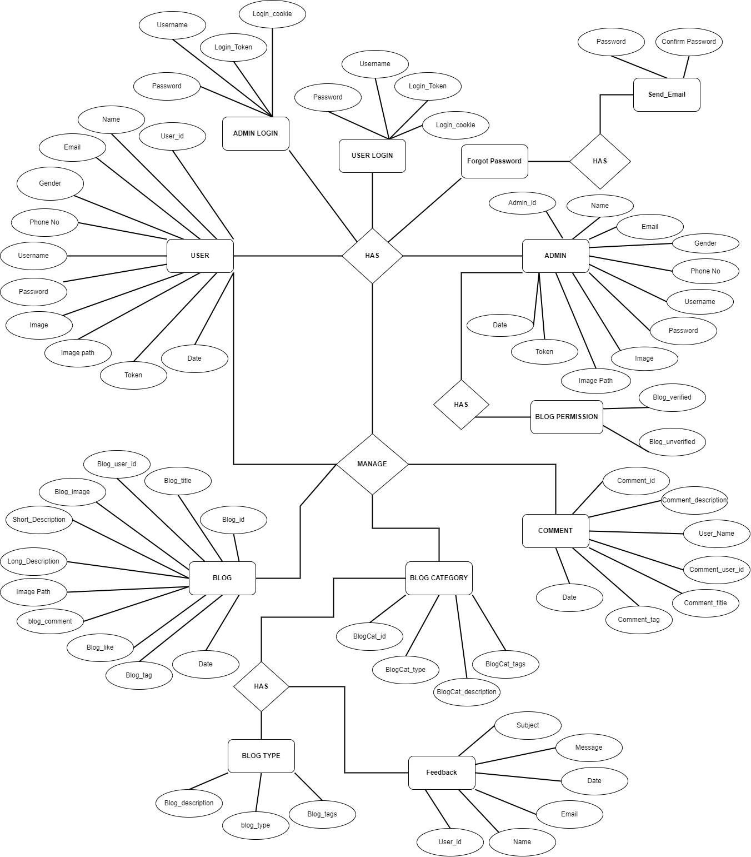

Entity-relationship diagram

Slide 20
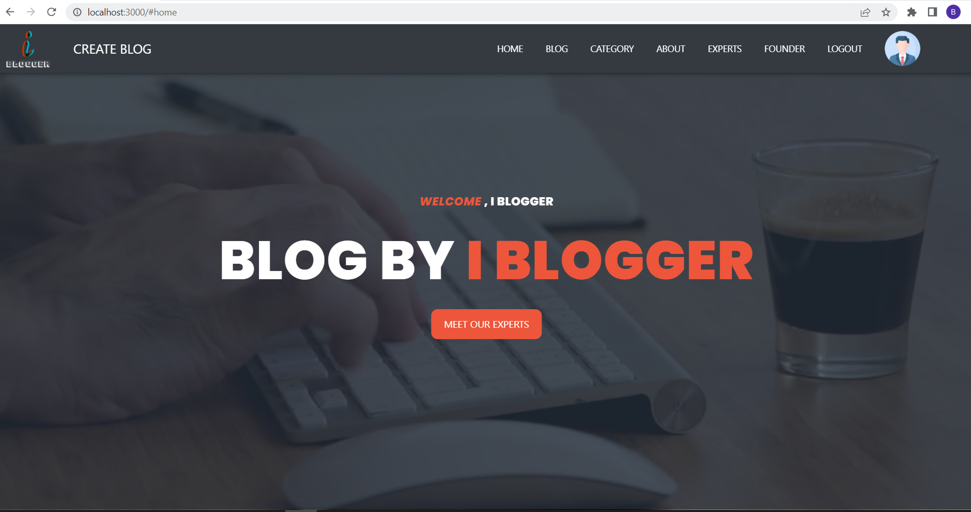
Input/output design
Frontend ( Home Page ) :-

Slide 21
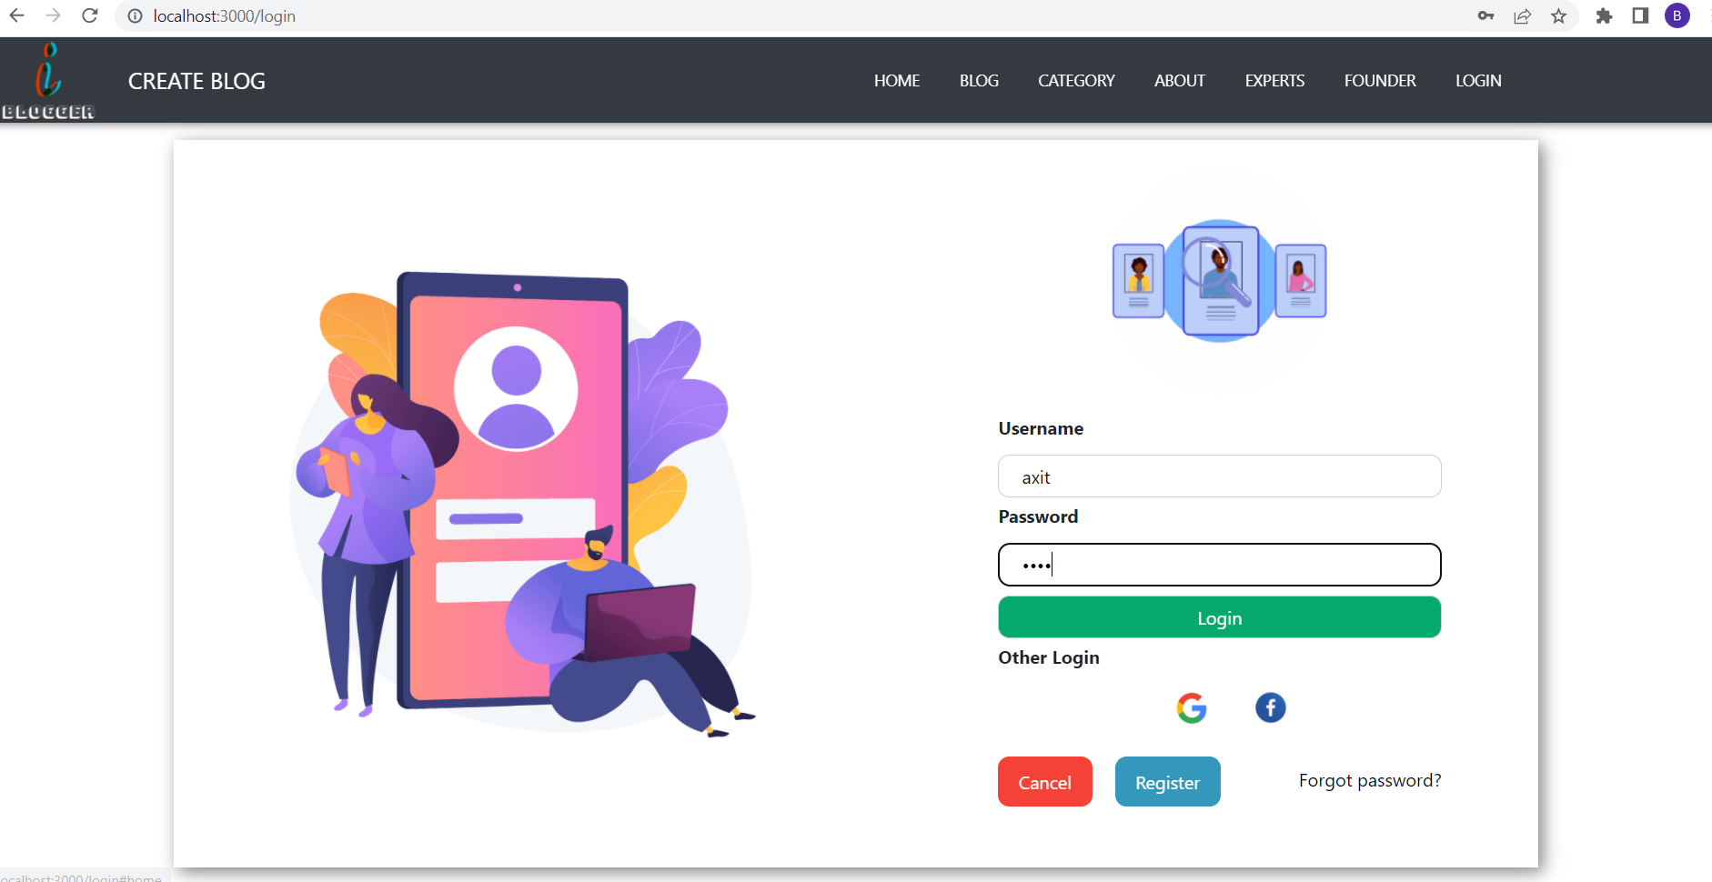
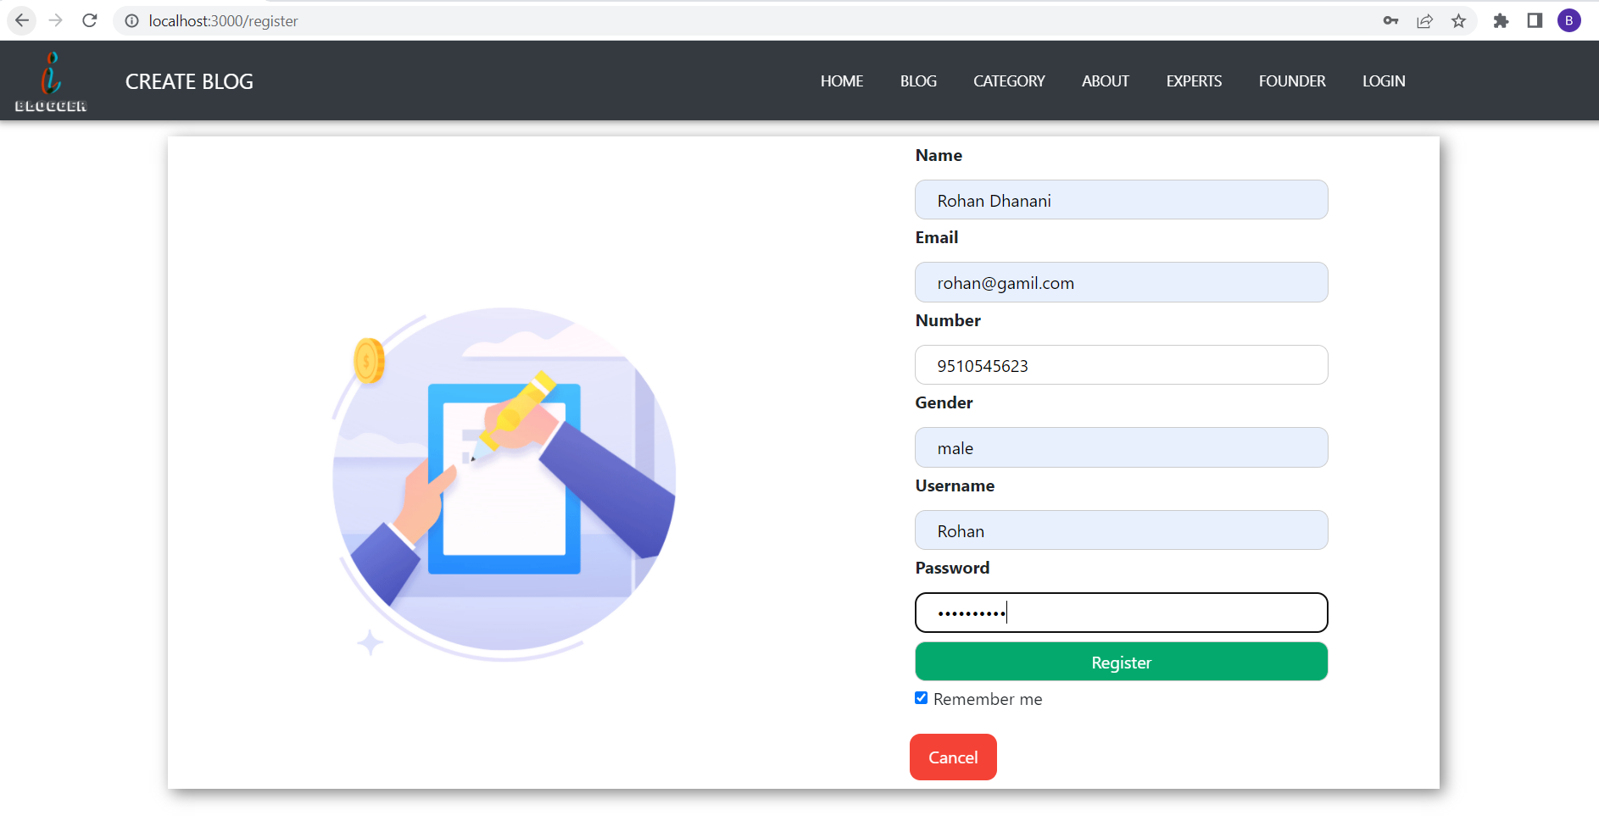
Frontend ( Login Page ) :-
Frontend ( Register Page ) :-

Slide 22
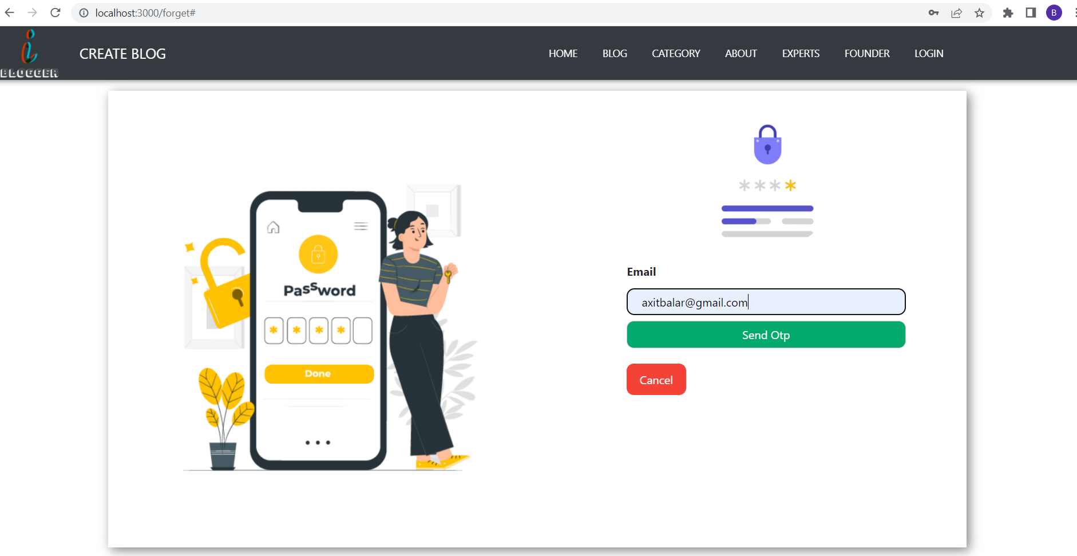
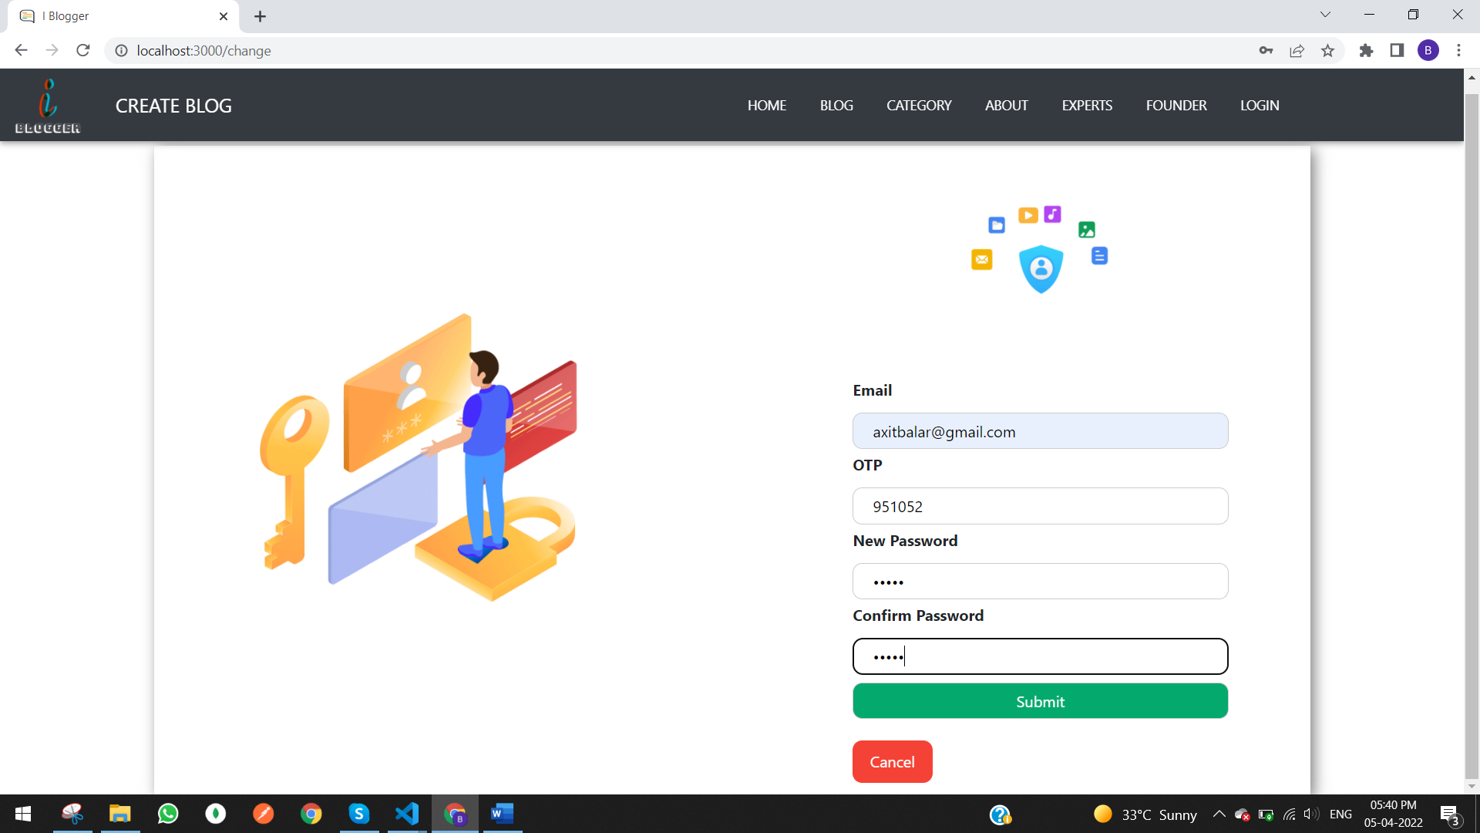
Frontend ( Send-Email-OTP Page ) :-
Frontend ( Forgot Password Page ) :-

Slide 23
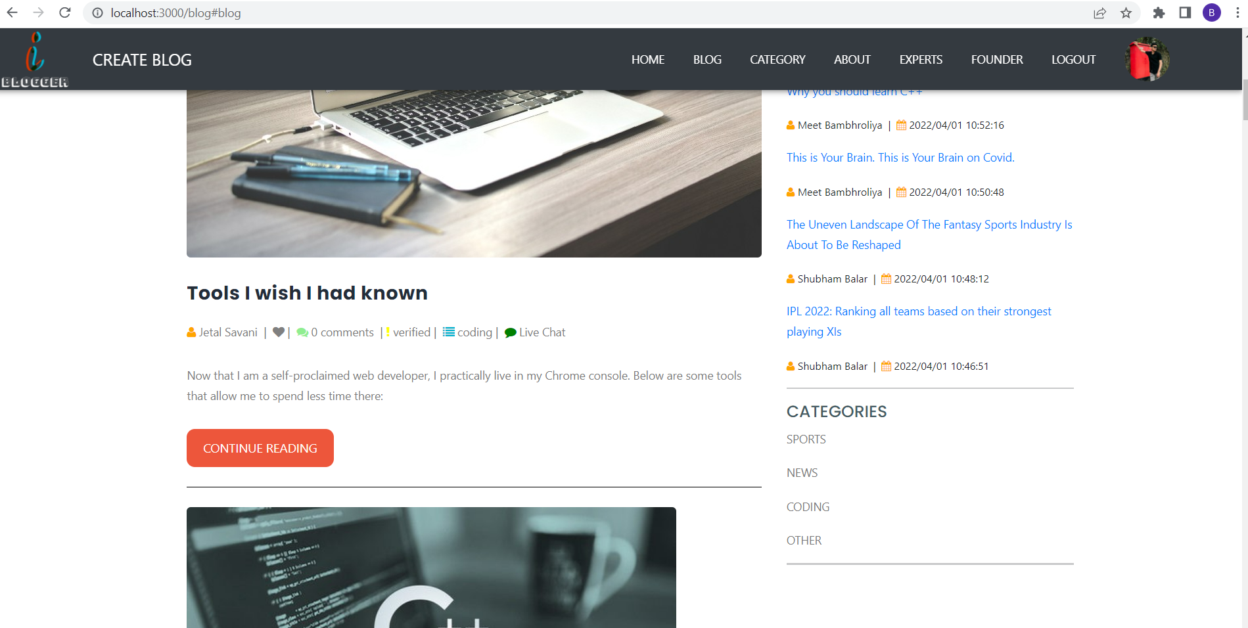
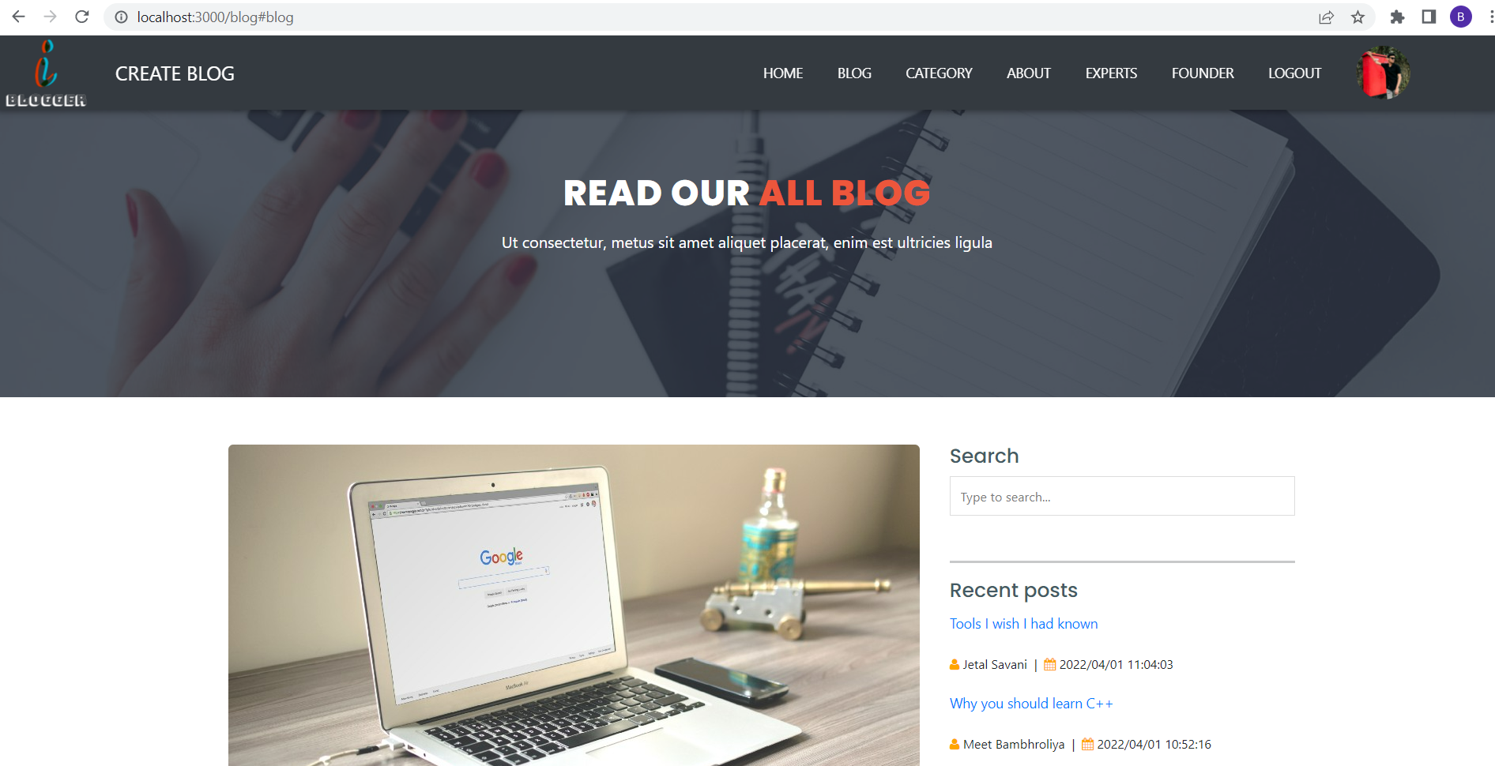
Frontend ( All-Blog Page ) :-

Slide 24
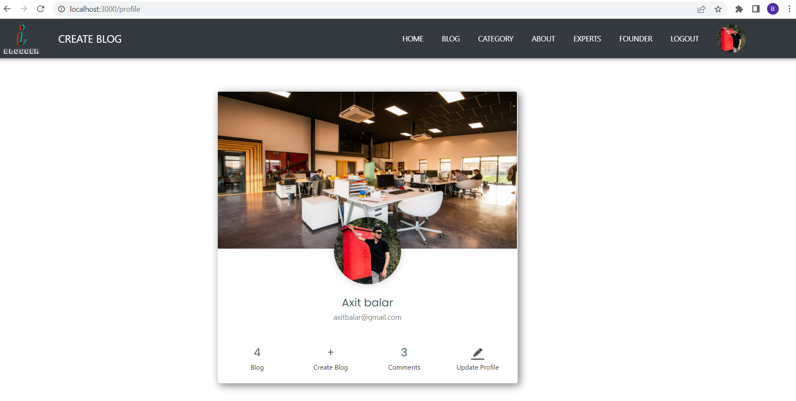
Frontend ( Profile Page ) :-

Slide 25
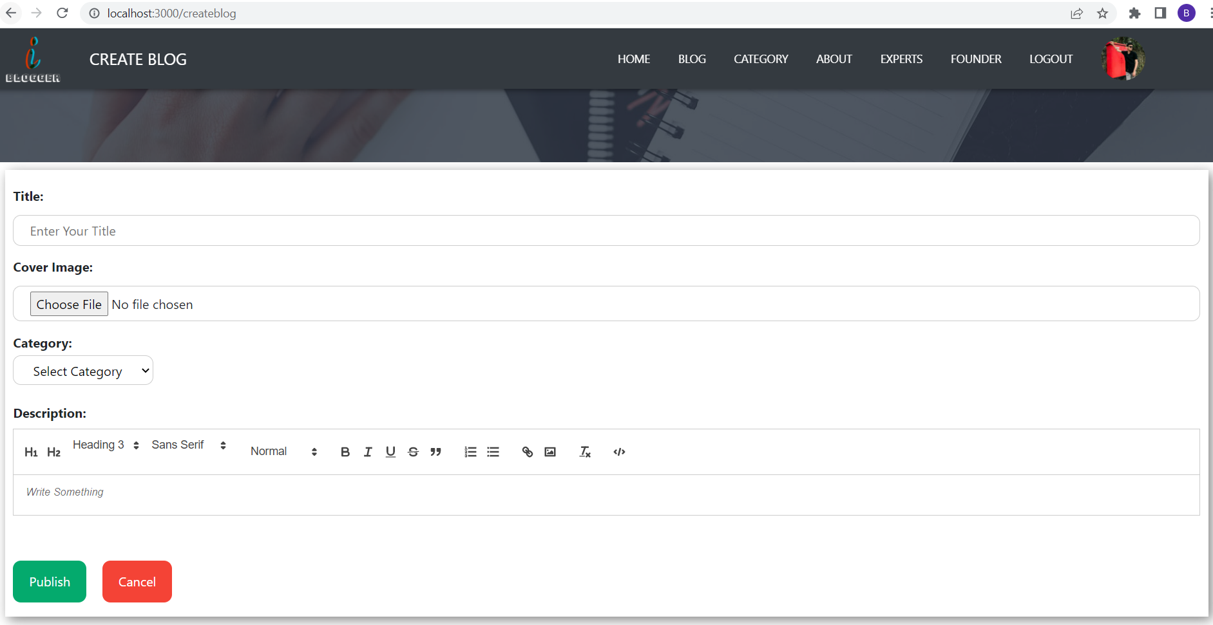
Frontend ( Create-Blog Page ) :-

Slide 26
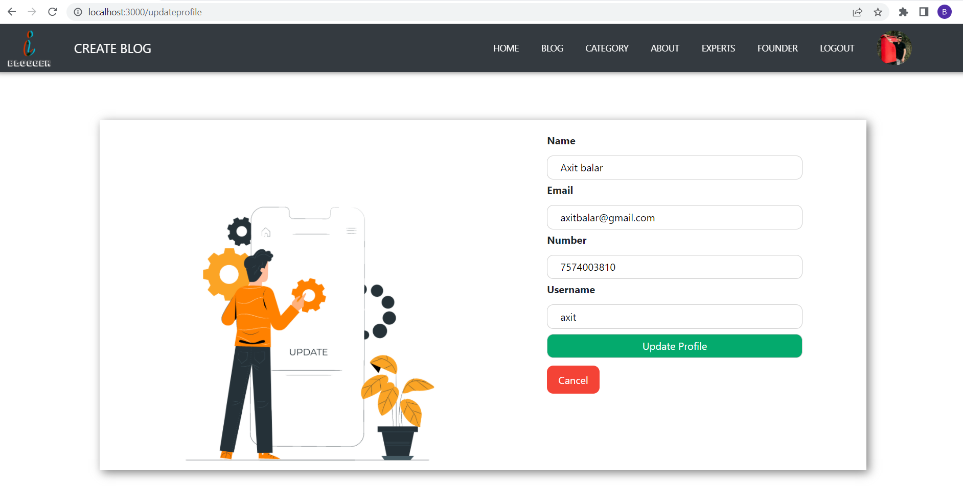
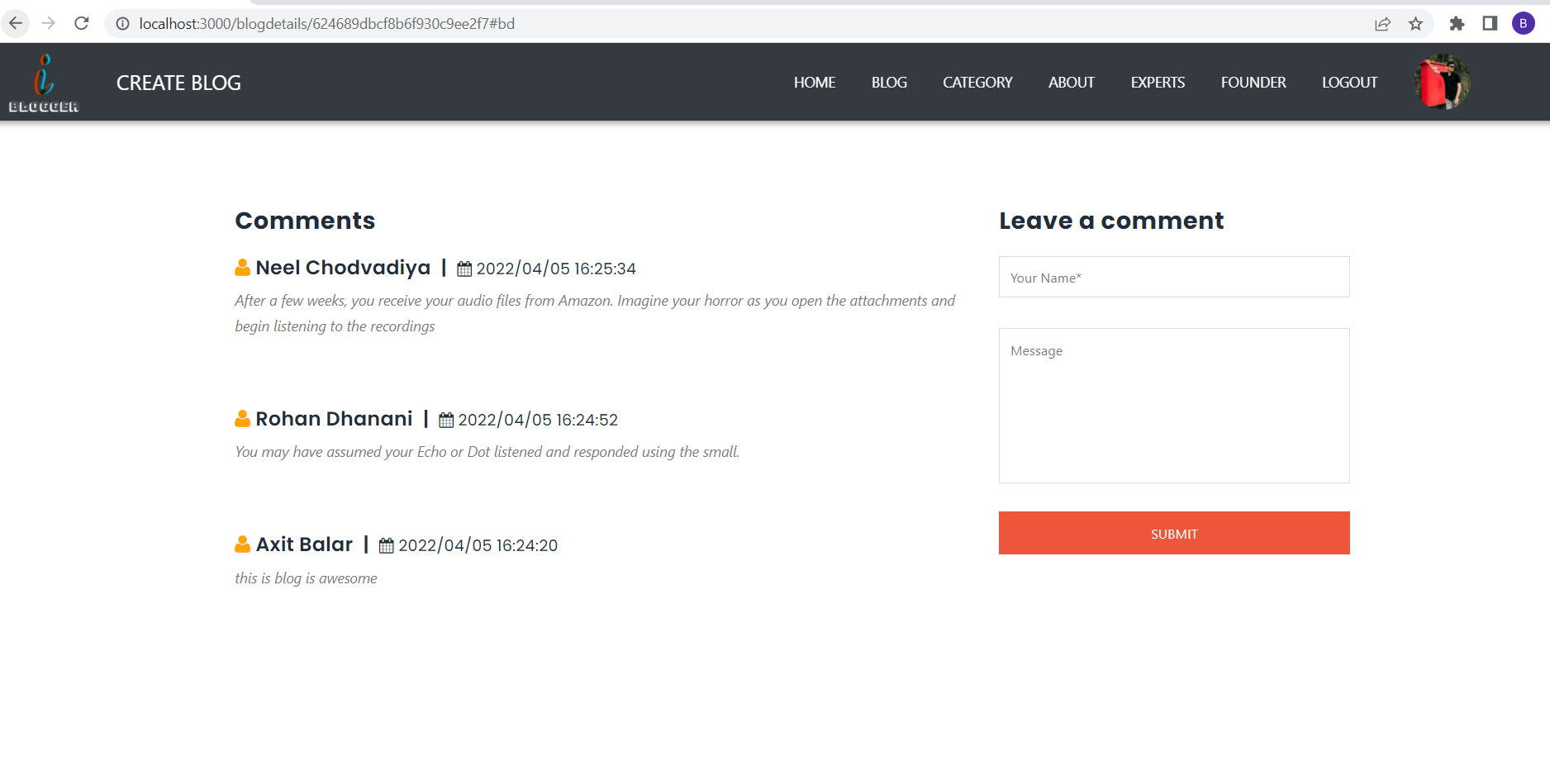
Frontend ( Edit-Profile Page ) :-
Frontend ( Comment Page ) :-

Slide 27
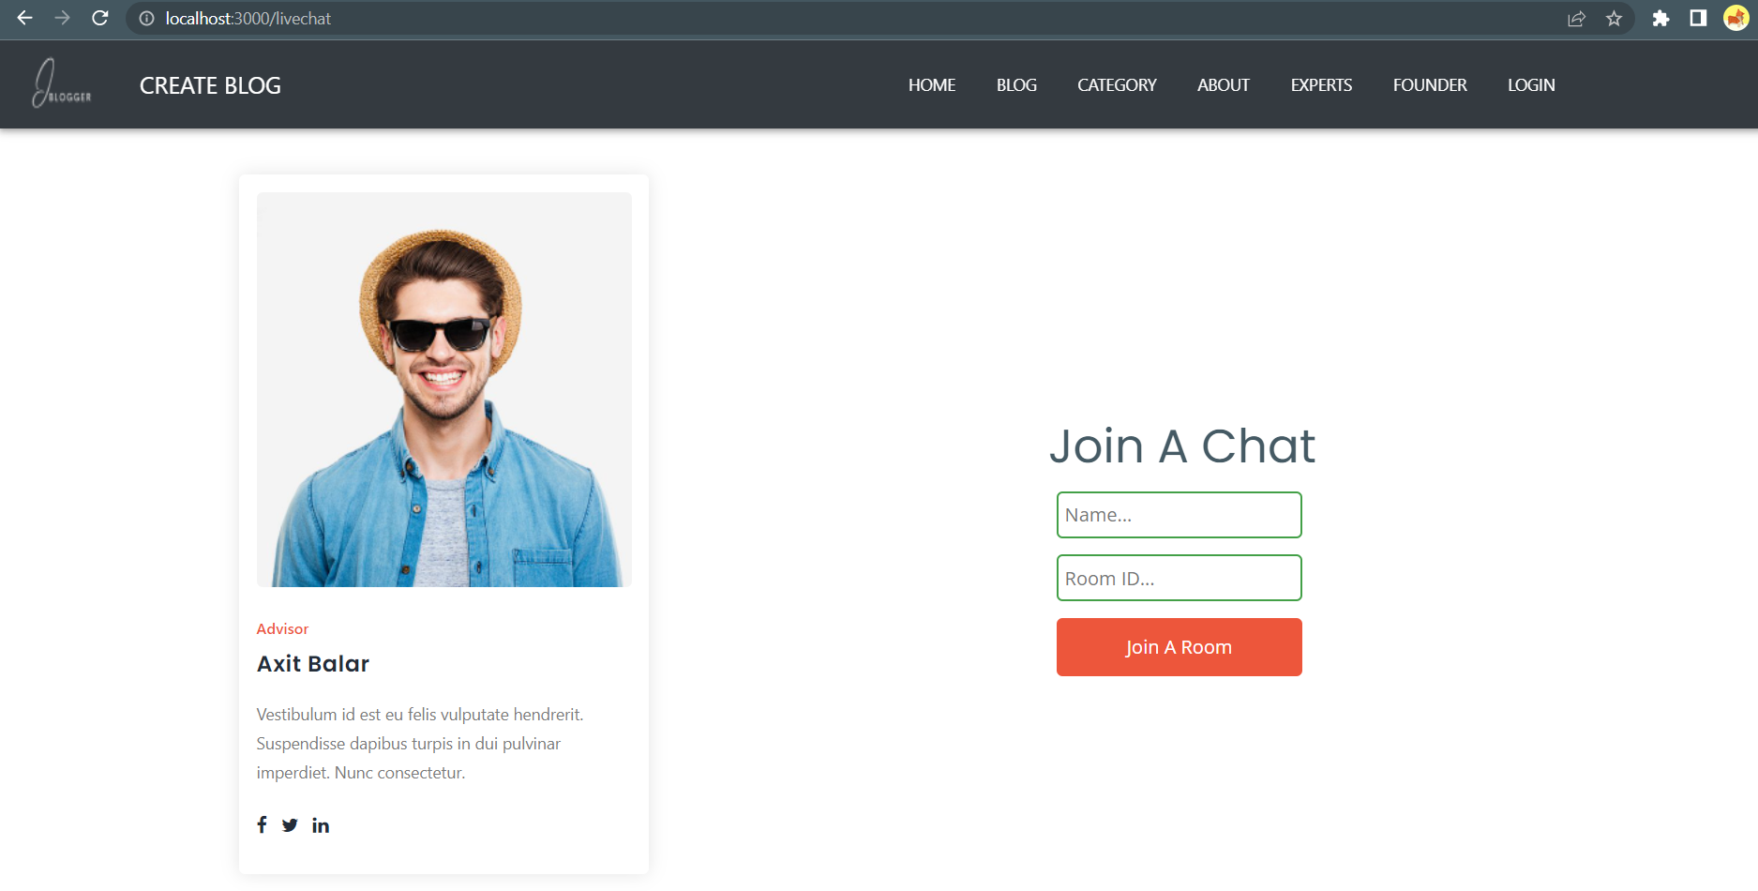
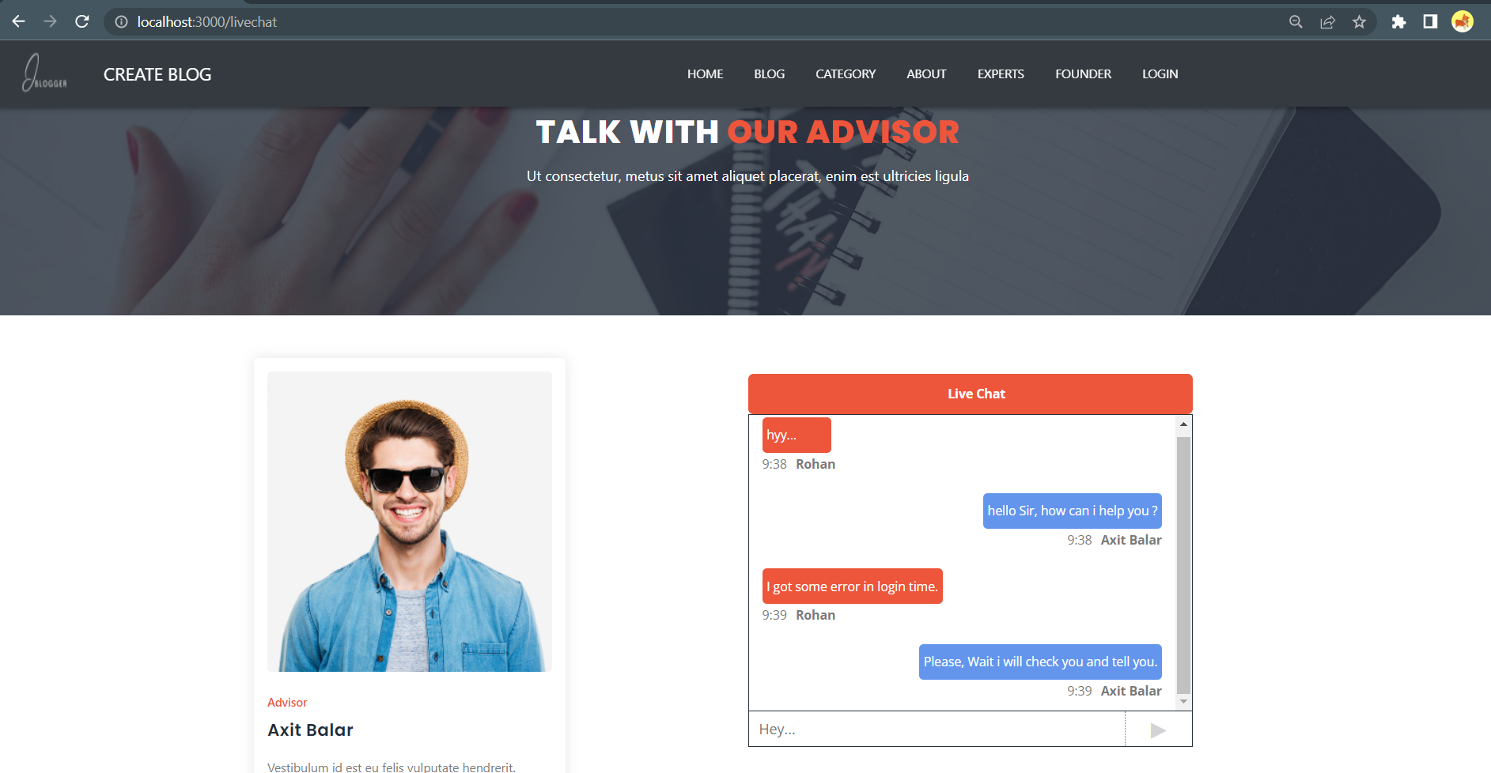
Frontend ( Live-Chat-With-Expert Page ) :-

Slide 28
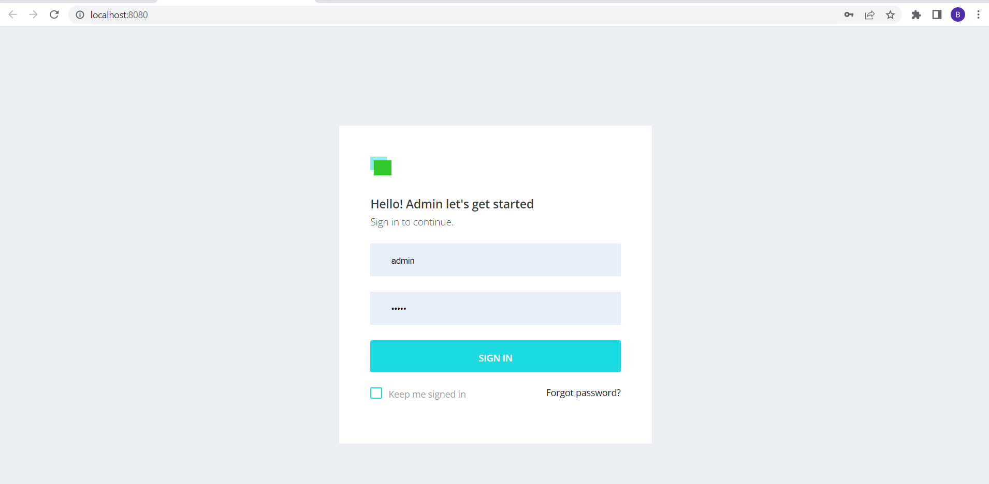
Admin Panel ( Login Page ) :-

Slide 29
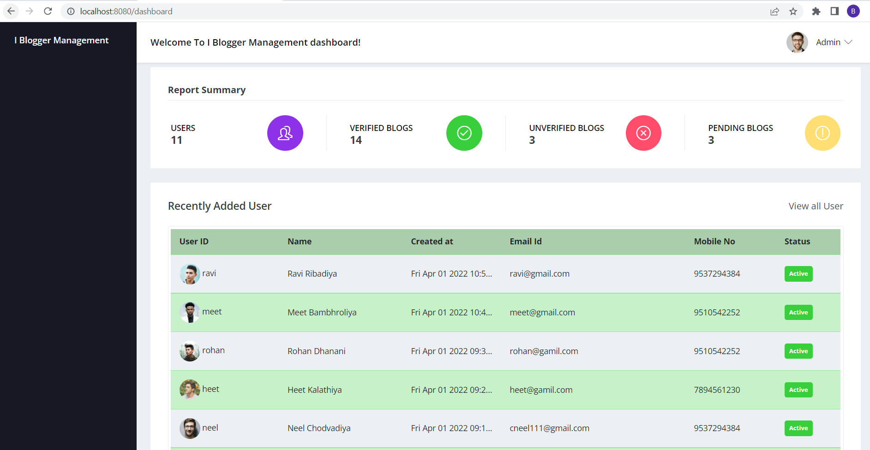
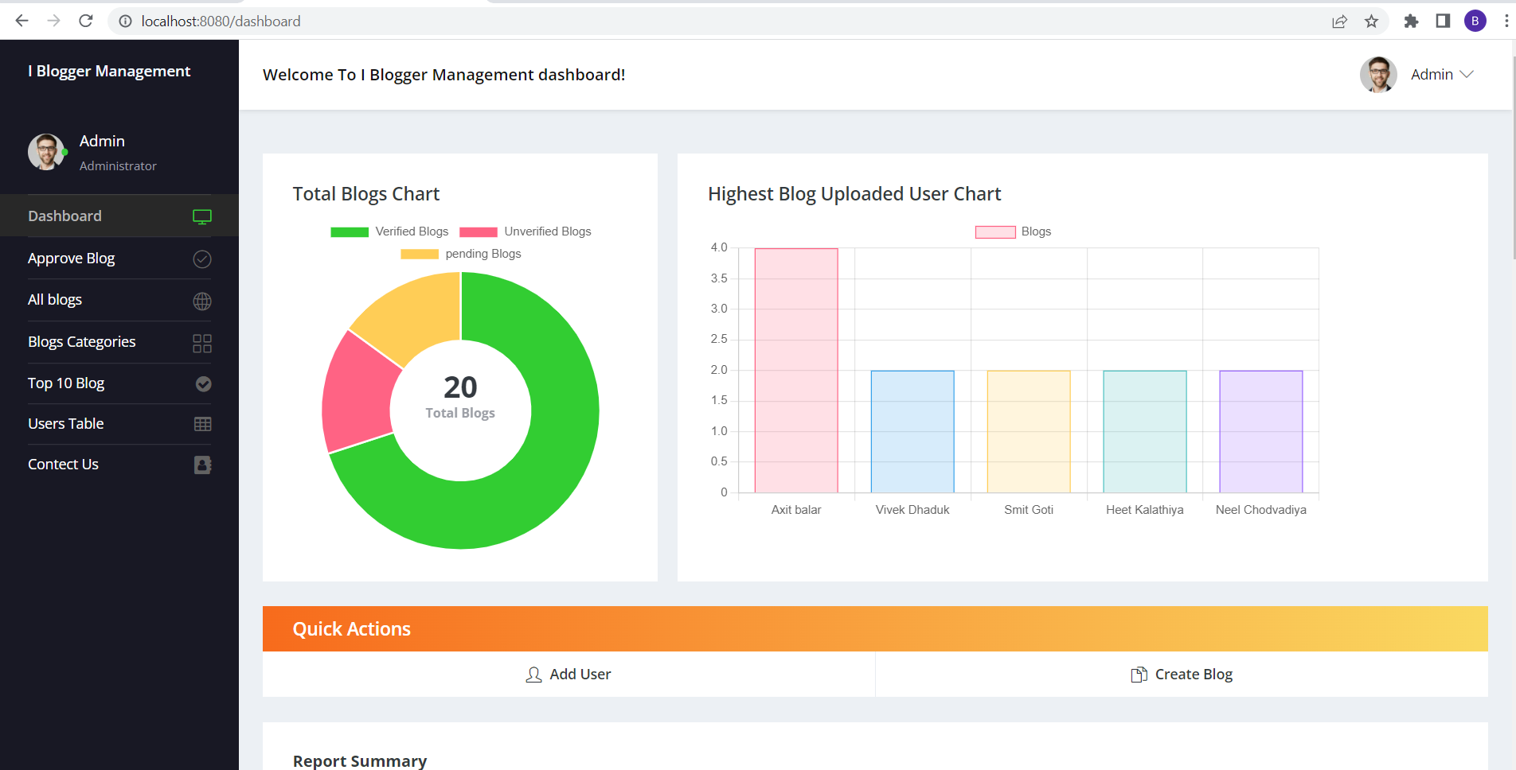
Admin Panel ( Dashboard Page ) :-

Slide 30
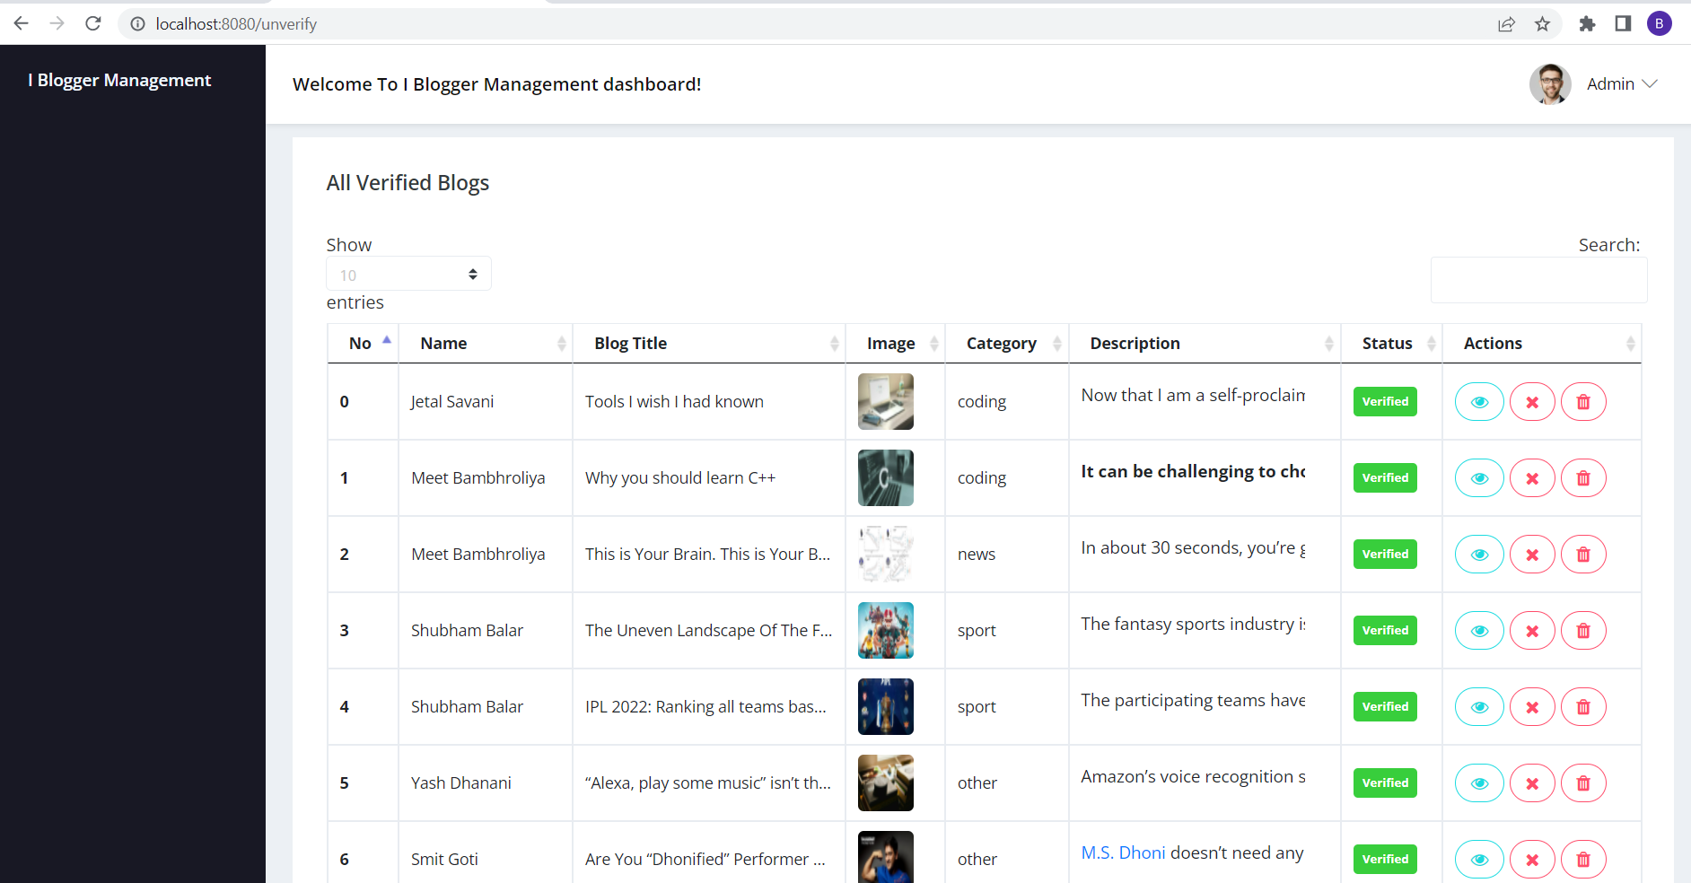
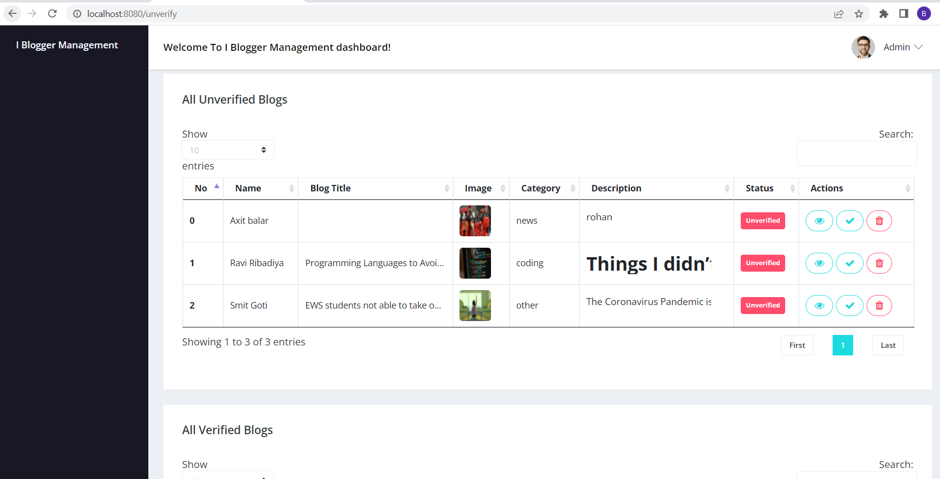
Admin Panel ( Approve Page ) :-

Slide 31
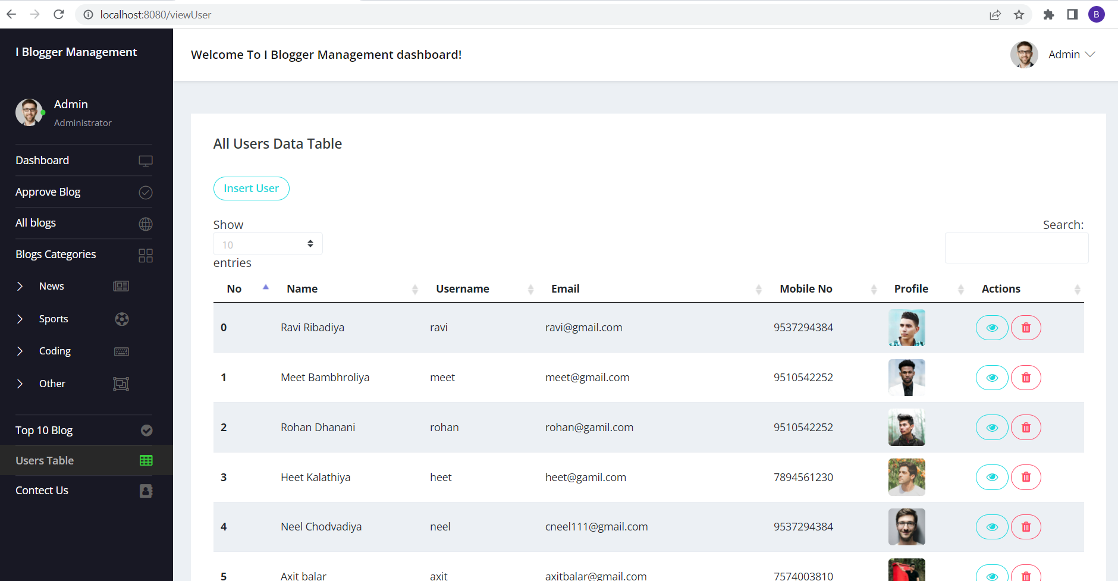
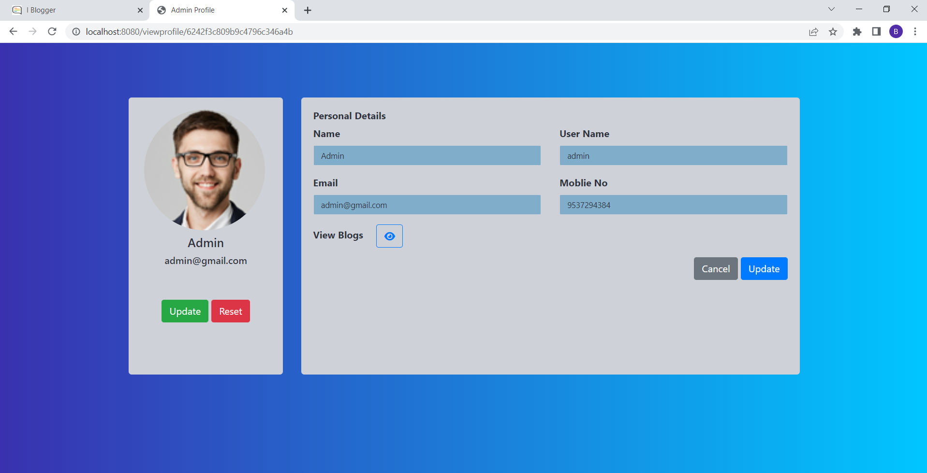
Admin Panel ( All-Users Page ) :-
Admin Panel ( Edit-Admin-Profile Page ) :-

Slide 32
Software testing
Software testing is a critical element of software quality assurance and represents the ultimate review of specification design and coding.
Testing is an exposure of a system to trial input to see whether software meets correct output. Testing cannot be determined whether software meets user’s needs, only whether it appears to confirm to requirements.
Testing can show that a system is free of errors, only that it contains error. Testing should therefore,
Validate Performance.
Detects errors.
Identify.
Inconsistencies.

Slide 33
Limitations of system
Since, every system has some limitations so our proposed system is also not untouchable in this regard.
The main limitations of our system are:
Excel export has not been developed for the blogs.
User cannot update blog image once it uploaded.
User can not share blogs in social media.
User cannot chat (blog user - user)

Slide 34
Future scope of enhancements
The social networking site have a wide range to change as per time requirement. That the reason behind that not a particular project is ever considered as complete, because what the demand of the user and thinking always change day by day.
Always do more than what have.
Some of the enhance which we have thought are:
We can give more advance software for online blogging system including more facilities.
We will host the platform on online server to make it accessible worldwide.
Integrate multiple load balancer to distribute the load of the server.
Implement the backup mechanism for taking backup of code base and database on regular basis on different servers.
Create a master and slave database structure to reduce the overload of the database queries.
User can create his own business page for advertisement.

Slide 35
references
https://stackoverflow.com/
https://dev.to/
https://medium.com/
https://www.blogger.com/about/?bpli=1
https://stackoverflow.blog/

